Slide 1
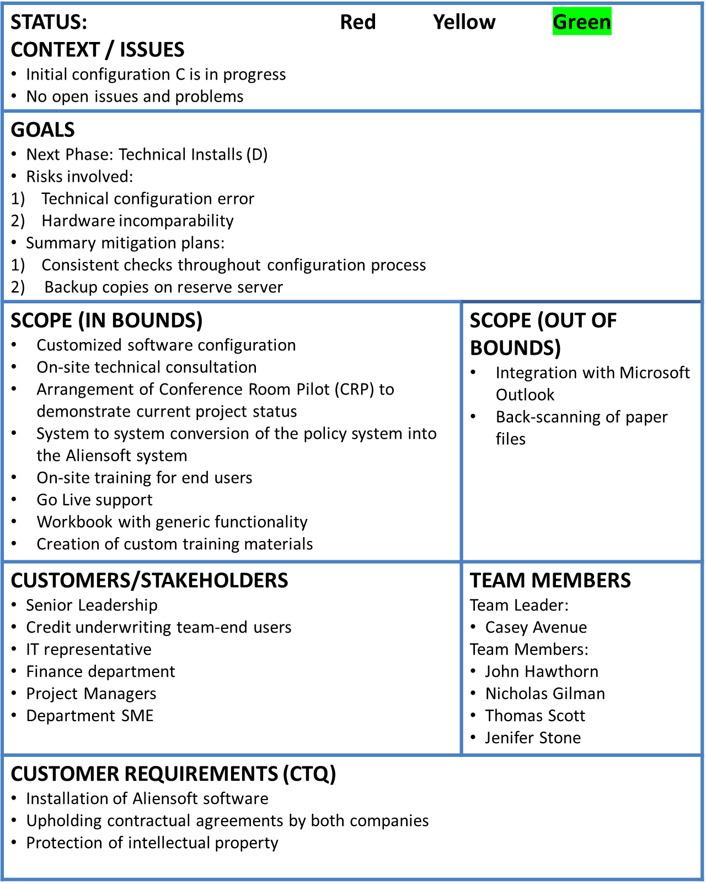
Aliensoft Implementation at AIP
March-20-2017
Tom DiCaprio
VISION OF SUCCESS Improved efficiency of underwriting department Consolidated repository of policy documents
PROJECT SCHEDULE
RESOURCES (other than team members) Time commitment for the project: 11 weeks External Resources: Aliensoft software license, legal paperwork Internal Resources: Office space, Conference rooms Equipment: Computer systems, basic necessary softwares Materials: Printers, VoIP, Stationery
Project Schedule | Owner | Planned Date | Actual Date | % Complete
1. Kickoff Meeting A | Casey Avenue | March 27 | March 27 | 100%
2. Initial Configuration B | Nicholas Gilman | April 3 | April 3 | 100%
3. Initial Configuration C | Nicholas Gilman | April 10 | April 10 | 10%
4. Technical Installs D | John Hawthorn | April 17 |  | 0%
5. Initial Configuration E | Nicholas Gilman | April 24 |  | 0%
6. Test Conversion F | John Hawthorn | May 1 |  | 0%
7. Conference Room Pilot Prep G | John Hawthorn | May 8 |  | 0%
7. Conference Room Pilot Prep (CRP) H | John Hawthorn | May 15 |  | 0%
9. Updated configuration, prep for Training week I | John Hawthorn | May 22 |  | 0%
10. Training Week J | Nicholas Gilman | May 29 |  | 0%
Weekend 10 to 11 Production Conversion K | John Hawthorn | June 3 |  | 0%
11. Go Live week L | Casey Avenue | June 5 |  | 0%
Aliensoft Team
Project Lead
Consultants
Senior Leadership
IT team
Trainer

Slide 2
AIP Aliensoft Risk Assessment
Description of the risk | Type of risk | Probability & Consequences | Risk Mitigation Strategy
Time overruns | Execution | 7% and $100000 = $7,000 | Careful planning and flexibility with recourses
Staff pulled away | Execution | 10% and $20000 = $2000 | Find backup recourses
Ineffective training | Contractual | 8% and $50,000 = $4000 | Find other company working with Aliensoft software as backup.
Installation fails | Contractual/Execution | 15% and $90,000 = $13500 | Accept.
Aliensoft financial/ staff problems | Contractual/ Legal | 5% and $200,000 = $10000 | Buy insurance for counteragents relationships.
Financial distress | Financial | 0.5% and 300,000 = $15,000 | Accept
 | 6 (Six) | $51,500
Notes:
In time overruns we consider overbudget cost of 10% (aliensoft professional services expenses and our expences on staff salaries.)
Staff pulled away we consider risks of loosing internal recourses that will cost us additional funds to find new employees with appropriate skills fast.
In ineffective training we consider a possibility that our employees will not be trained sufficiently and we ll need to hire new contractors for additional training.
In installation fails we take into account potential income loss and potential losses of prepaid services for Aliensoft.
In Aliensoft financial/ staff problems we take into account potential litigation fees.
In Financial Distress we considering a situation when all insurance industry will come into struggle and new software won’t be required due to a reduction of the underwriting department staff.

Slide 3
Budget Estimation
# | Activity | Week | Cumulative Budget - No Contingency | Cumulative Budget - With Contingency | Actual Cumulative Expenses | Cost Variance (EV-AC) - No Contingency
1 | Kickoff Meeting | 1 | $ 6,600 | $ 7,708 | $ - | $ 6,600
2 | Initial Configuration | 2 | $ 13,400 | $ 15,617 | $ - | $ 13,400
3 | Initial Configuration | 3 | $ 20,200 | $ 23,525 | $ - | $ 20,200
4 | Technical Installs | 4 | $ 33,700 | $ 38,133 | $ - | $ 33,700
5 | Initial Configuration | 5 | $ 40,600 | $ 46,142 | $ - | $ 40,600
6 | Test Conversion | 6 | $ 48,100 | $ 54,750 | $ - | $ 48,100
7 | Conference Room Pilot Prep | 7 | $ 54,075 | $ 61,833 | $ - | $ 54,075
8 | Conference Room Pilot (CRP) | 8 | $ 63,575 | $ 72,442 | $ - | $ 63,575
9 | Updated configuration, prep for Training week | 9 | $ 69,575 | $ 79,550 | $ - | $ 69,575
10 | Training Week | 10 | $ 86,025 | $ 97,108 | $ - | $ 86,025
 | Production Conversion | 0 | $ 100,025 | $ 112,217 | $ - | $ 100,025
11 | Go Live week | 11 | $ 111,625 | $ 124,925 | $ - | $ 111,625

Slide 4
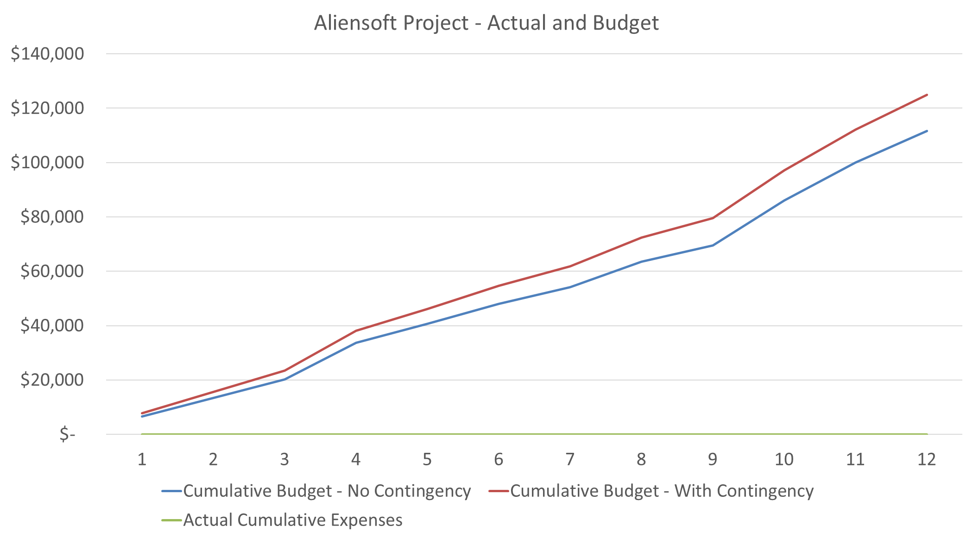
Budget Estimation

